Slide 1
Checking and securing solving linear equations
Expressions and formulae

Slide 2
how to use Oak lessons

Slide 3
I can solve equations involving brackets.

Slide 4
The additive inverse of a number is a number that, when added to the original number, gives the sum of 0.
The reciprocal is the multiplicative inverse of any non-zero number. Any non-zero number multiplied by its reciprocal is equal to 1
Like terms are terms that have the same set of variables and corresponding exponents.

Slide 5

Checking and securing solving linear equations
Solving equations involving a bracketed expression
Solving equations with multiple brackets

Slide 6
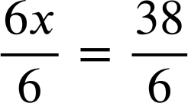
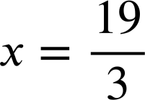
Solving equations involving a bracketed expression
When we see equations with brackets we can expand the brackets to solve.
6(x − 1) | = | 32
6x − 6 | = | 32
6x − 6 + 6 | = | 32 + 6
6x | = | 38
6(x − 1) | = | 32
6x − 6 | = | 32
6x − 6 + 6 | = | 32 + 6
6(x − 1) | = | 32
6x − 6 | = | 32
6(x − 1) | = | 32
6 × x + 6 × −1 = 6x − 6
This format looks very familiar. From here we can solve by manipulating.
The additive inverse of −6 is +6
When the answer is not an integer it is easiest to leave your answer as a fraction. It is useful to write fractions in their simplest form.

Slide 7

Solving equations involving a bracketed expression
Solve this equation by expanding the brackets.
Solve this equation by expanding the brackets.
3(2x + 8) | = | 6
6x + 24 | = | 6
6x | = | −18
x | = | −3
3(2x + 8) | = | 6
6x + 24 | = | 6
6x | = | −18
3(2x + 8) | = | 6
6x + 24 | = | 6
3(2x + 8) | = | 6
4(3x + 20) | = | 20
12x + 80 | = | 20
12x | = | −60
x | = | −5
4(3x + 20) | = | 20
12x + 80 | = | 20
12x | = | −60
4(3x + 20) | = | 20
12x + 80 | = | 20
4(3x + 20) | = | 20
Check the solution by substitution.
Check the solution by substitution.
3(2(−3) + 8) | = | 6
3(−6+ 8) | = | 6
3(2) | = | 6
3(2(−3) + 8) | = | 6
3(−6+ 8) | = | 6
3(2(−3) + 8) | = | 6
4(3(−5) + 20) | = | 20
4(−15 + 20) | = | 20
4(5) | = | 20

Slide 8
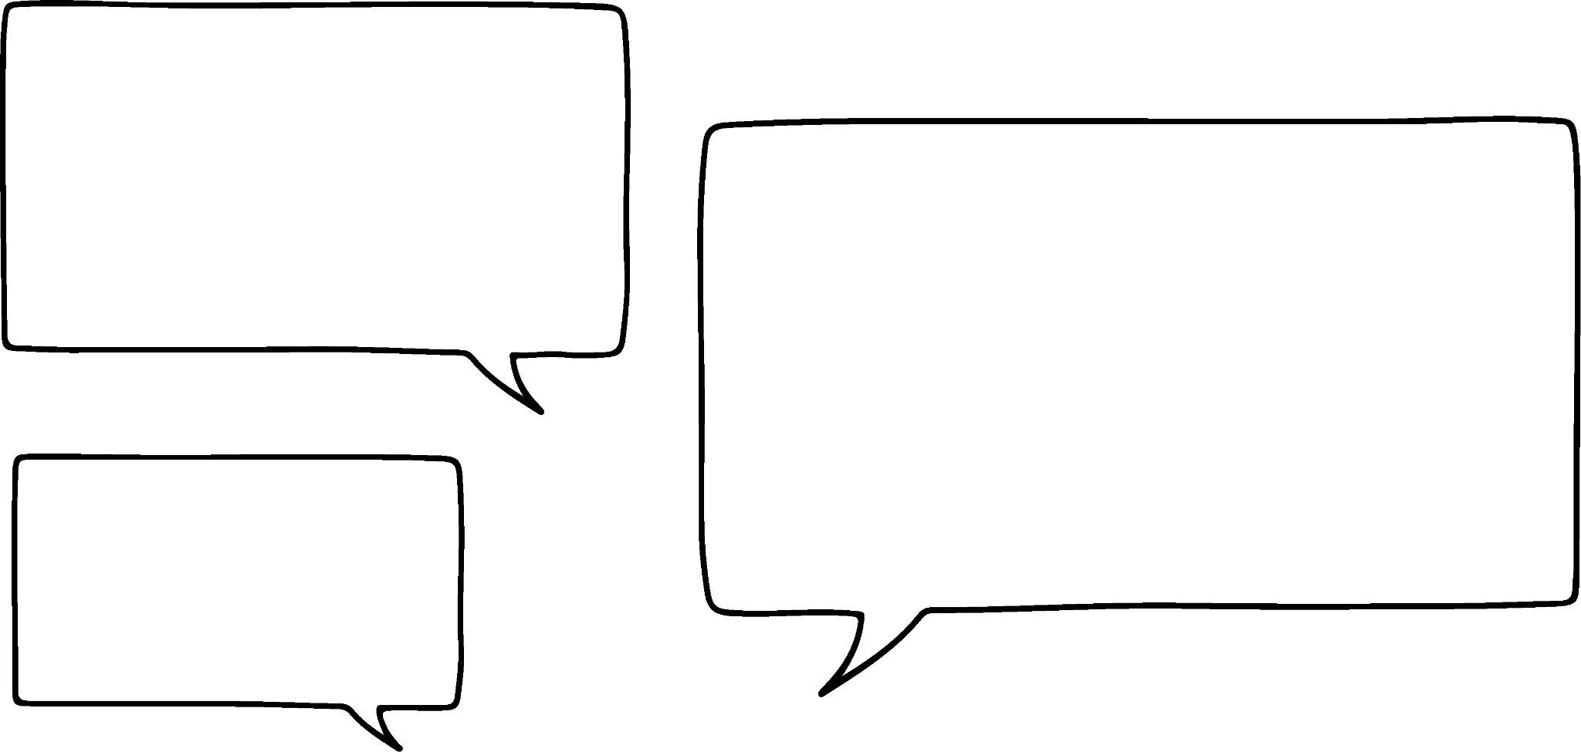

Solving equations involving a bracketed expression
I think I saw a quicker way with that last question.
4(3x + 20) = 20
Can you see what Jun has spotted?
4 is a common factor of the expressions on both sides of the equation
Jun
Where we see common factors dividing by the coefficient of the bracket could be the quickest solution.
4(3x + 20) | = | 20
3x + 20 | = | 5
3x | = | −15
x | = | −5
4(3x + 20) | = | 20
3x + 20 | = | 5
3x | = | −15
4(3x + 20) | = | 20
3x + 20 | = | 5
Both sides have been divided by 4

Slide 9
Solving equations involving a bracketed expression
Jun is solving more equations with brackets.
Expanding first:
Multiplying by the reciprocal first:
3(x − 2) | = | 15
3x − 6 | = | 15
3x | = | 21
x | = | 7
3(x − 2) | = | 15
3(x − 2) | = | 15
x − 2 | = | 5
x | = | 7
3(x − 2) | = | 15
I wonder which way will be easiest for this example.

Slide 10
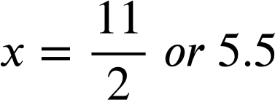
Solving equations involving a bracketed expression
Jun is solving more equations with brackets.
Expanding first:
Multiplying by the reciprocal first:
8(x − 3) | = | 20
8x − 24 | = | 20
8x | = | 44
8(x − 3) | = | 20
8(x − 3) | = | 20
8x − 24 | = | 20
8(x − 3) | = | 20
I think I have found an example where expanding the brackets will be easier.

Slide 11
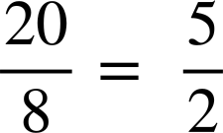
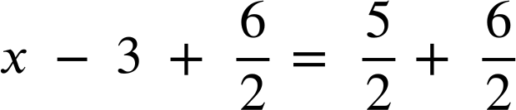
Solving equations involving a bracketed expression
Jun is solving more equations with brackets.
Expanding first:
Multiplying by the reciprocal first:
8(x − 3) | = | 20
8x − 24 | = | 20
8x | = | 44
8(x − 3) | = | 20
x − 3 | =
Dividing first meant more calculations with fractions. It is personal preference which method you find easiest for each question.

Slide 12
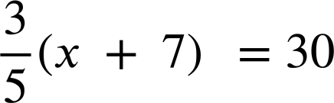
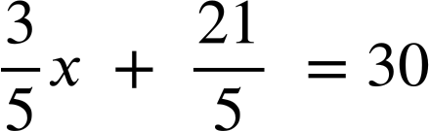
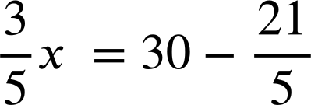
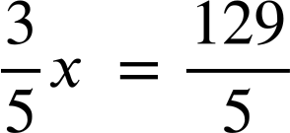
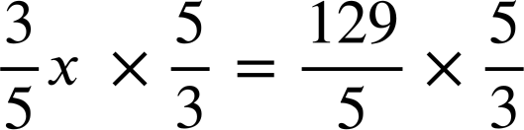

Solving equations involving a bracketed expression
When the coefficient of the bracket is a fraction, expanding the bracket can be time consuming and lead to some tricky calculations.

Slide 13

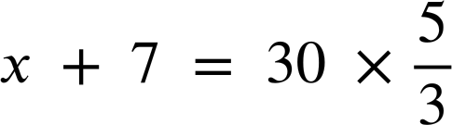

Solving equations involving a bracketed expression
Have a go at solving this equation by dividing both sides of the equation by
Remember, dividing by a fraction is the same as multiplying by the reciprocal.
That was much easier than expanding the brackets first.

Slide 14
Solving equations involving a bracketed expression
The equation 5(x + 4) = 50 must be solved by expanding the brackets first.
All equations are easier to solve if you divide by the coefficient of the bracket first.
5 and 50 have a common factor so dividing by the coefficient of the bracket may be easier.

Slide 15

Solving equations involving a bracketed expression
Which first step makes the equation 7(x + 3) = 32 easier to solve?
Expanding the brackets
Adding 3 to both sides
Multiplying both sides by
Dividing both sides by 7

Slide 16


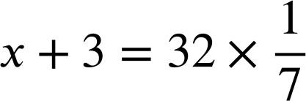
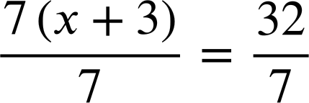
Solving equations involving a bracketed expression
Which first step makes the equation 7(x + 3) = 32 easier to solve?
Expanding the brackets works the best in this case.
Adding 3 does not help us solve the equation.
Multiplying by a seventh and dividing by 7 are equivalent. Both will help us solve the equation however 7 is not a factor of 32 so this method will require more fraction calculations.

Slide 17
Solving equations involving a bracketed expression
1) Spot the mistake in each method to solve an equation involving brackets.
a)
b)
c)
5(x + 10) | = | 55
5x + 10 | = | 55
5x | = | 45
x | = | 9
2(4x + 10) | = | 18
2x + 5 | = | 9
2x | = | 4
x | = | 2
7(x − 3) | = | 42
x − 3 | = | 6
x | = | 3

Slide 18


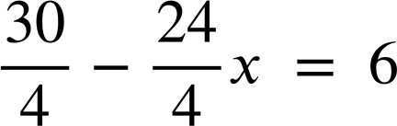
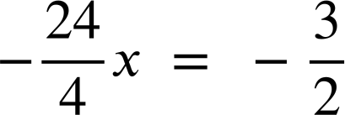
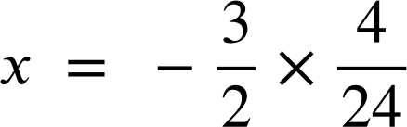
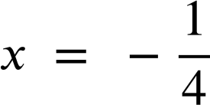
Solving equations involving a bracketed expression
1) Spot the mistake in each method to solve an equation involving brackets.
d)
e)
f)
5(3x + 2) | = | 14
8x + 10 | = | 14
8x | = | 4
x | = | 2
(2x − 5) | = | 15
2x − 5 | = | 3
2x | = | 8
x | = | 4
(10 − 8x) | = | 6

Slide 19
Solving equations involving a bracketed expression
2a) Solve this equation using both methods and write a sentence comparing the efficiency of the methods.
Expanding first:
Multiplying by the reciprocal first:
6(x − 9) | = | 21
6(x − 9) | = | 15

Slide 20
Solving equations involving a bracketed expression
2b) Solve this equation using both methods and write a sentence comparing the efficiency of the methods.
Expanding first:
Multiplying by the reciprocal first:
15(4x + 7) | = | 45
15(4x + 7) | = | 45

Slide 21
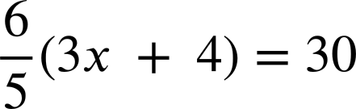
Solving equations involving a bracketed expression
2c) Solve this equation using both methods and write a sentence comparing the efficiency of the methods.
Expanding first:
Multiplying by the reciprocal first:

Slide 22
Solving equations involving a bracketed expression
1) Spot the mistake in each method to solve an equation involving brackets.
a)
b)
c)
5(x + 10) | = | 55
5x + 10 | = | 55
5x | = | 45
x | = | 9
2(4x + 10) | = | 18
2x + 5 | = | 9
2x | = | 4
x | = | 2
7(x − 3) | = | 42
x − 3 | = | 6
x | = | 3
The additive inverse of −3 is + 3 so 3 should have been added to both sides. Line 3 should be x = 6 + 3 or x = 9
The brackets have not been expanded properly.
The second line should be 5x + 50 = 55
When dividing the LHS by 2 the terms in the bracket should not be divided.The second line should be 4x + 10 = 9

Slide 23
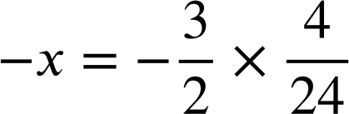
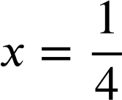
Solving equations involving a bracketed expression
1) Spot the mistake in each method to solve an equation involving brackets.
d)
e)
f)
5(3x + 2) | = | 14
8x + 10 | = | 14
8x | = | 4
x | = | 2
(2x − 5) | = | 15
2x − 5 | = | 3
2x | = | 8
x | = | 4
(10 − 8x) | = | 6
The brackets have not been expanded properly 5 and 3 should be multiplied not added. The second line should be 15x + 10 = 55
The reciprocal of a third is three.
The first step should be to multiply by 3 not divide by 3.
It would have been easier to multiply by the reciprocal first.

Slide 24
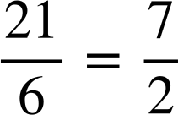
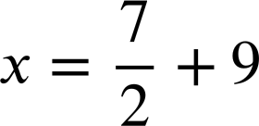
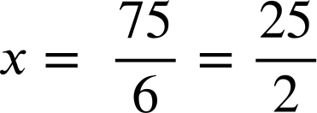
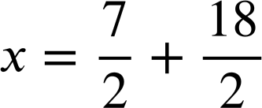
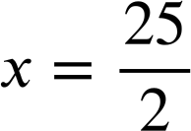
Solving equations involving a bracketed expression
2a) Solve this equation using both methods and write a sentence comparing the efficiency of the methods.
Expanding first:
Multiplying by the reciprocal first:
6(x − 9) | = | 21
6x − 54 | = | 21
6x | = | 75
6(x − 9) | = | 21
x − 9 | =
The second method requires a lot more fractions skills so the first method is likely to be more efficient.

Slide 25
Solving equations involving a bracketed expression
2b) Solve this equation using both methods and write a sentence comparing the efficiency of the methods.
Expanding first:
Multiplying by the reciprocal first:
15(4x + 7) | = | 45
60x + 105 | = | 45
60x | = | −60
x | = | −1
15(4x + 7) | = | 45
4x + 7 | = | 3
4x | = | −4
x | = | −1
This is personal preference. Both expressions have a common factor of 15 so dividing by 15 first makes the values smaller and potentially easier to work with compared to expanding the brackets first.

Slide 26
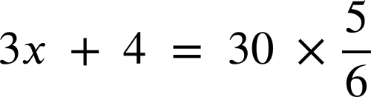








Solving equations involving a bracketed expression
2c) Solve this equation using both methods and write a sentence comparing the efficiency of the methods.
Expanding first:
Multiplying by the reciprocal first:
It is much easier to ‘undo’ the multiplicative step first this time as is an integer

Slide 27
Checking and securing solving linear equations
Solving equations involving a bracketed expression
Solving equations with multiple brackets

Slide 28
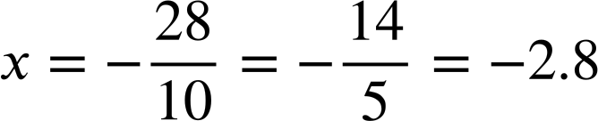
Solving equations with multiple brackets
We can solve equations which have unknowns on both sides.
For example
6(x + 3) | = | −2(2x + 5)
6x + 18 | = | −4x − 10
6x + 18 + 4x | = | −4x − 10 + 4x
10x + 18 | = | − 10
10x | = | − 28
6(x + 3) | = | −2(2x + 5)
6x + 18 | = | −4x − 10
6x + 18 + 4x | = | −4x − 10 + 4x
10x + 18 | = | − 10
6(x + 3) | = | −2(2x + 5)
6x + 18 | = | −4x − 10
6x + 18 + 4x | = | −4x − 10 + 4x
6(x + 3) | = | −2(2x + 5)
6x + 18 | = | −4x − 10
6(x + 3) | = | −2(2x + 5)
We can start by expanding the brackets.
Add the additive inverse of −4x
Solve the resulting two-step equation.

Slide 29

Solving equations with multiple brackets
Lucas
Lucas has a go at solving this equation.
Can you explain what he has done at every step?
2(3 − 2x) | = | 6(x + 5)
6 − 4x | = | 6x + 30
6 − 10x | = | 30
−10x | = | 24
−x | = | 2.4
x | = | −2.4
Expanded both brackets
Added −6x to both sides
Added −6 to both sides
Divided both sides by 10
Multiplied/ divided both sides by −1
Is there anything that you would do differently?

Slide 30
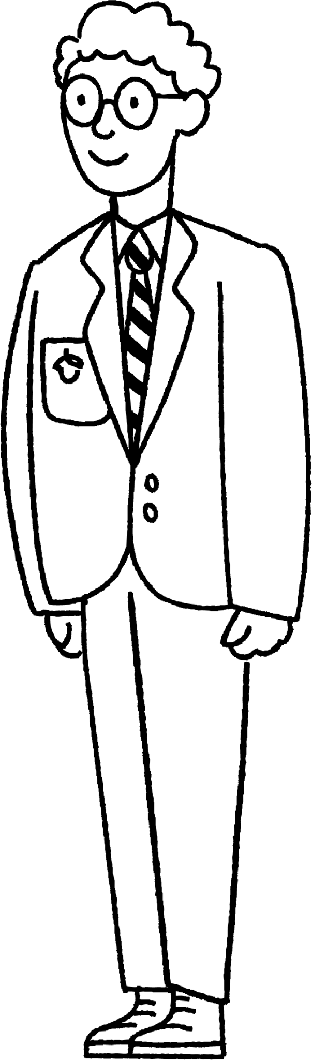
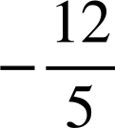
Solving equations with multiple brackets
2(3 − 2x) | = | 6(x + 5)
1(3 − 2x) | = | 3(x + 5)
3 − 2x | = | 3x + 15
3 | = | 5x + 15
−12 | = | 5x
 | = | x
There is a common factor on both sides of the equation. What would happen if I start by dividing by 2?
2(3 − 2x) | = | 6(x + 5)
1(3 − 2x) | = | 3(x + 5)
3 − 2x | = | 3x + 15
3 | = | 5x + 15
−12 | = | 5x
2(3 − 2x) | = | 6(x + 5)
1(3 − 2x) | = | 3(x + 5)
3 − 2x | = | 3x + 15
3 | = | 5x + 15
2(3 − 2x) | = | 6(x + 5)
1(3 − 2x) | = | 3(x + 5)
3 − 2x | = | 3x + 15
2(3 − 2x) | = | 6(x + 5)
1(3 − 2x) | = | 3(x + 5)
2(3 − 2x) | = | 6(x + 5)
Alex
I am going to add 2x then all my terms are positive.
What would you do next?
Many options: ‘add 2x’ or ‘add −3’ or ‘add −15’ or ‘add −3x’

Slide 31
Solving equations with multiple brackets
Solve the equation
Solve the equation
3(6 − 4x) | = | 4(2x − 5)
18 − 12x | = | 8x − 20
18 | = | 20x − 20
38 | = | 20x
19 | = | 10x
1.9 | = | x
3(6 − 4x) | = | 4(2x − 5)
18 − 12x | = | 8x − 20
18 | = | 20x − 20
38 | = | 20x
19 | = | 10x
3(6 − 4x) | = | 4(2x − 5)
18 − 12x | = | 8x − 20
18 | = | 20x − 20
38 | = | 20x
3(6 − 4x) | = | 4(2x − 5)
18 − 12x | = | 8x − 20
18 | = | 20x − 20
3(6 − 4x) | = | 4(2x − 5)
18 − 12x | = | 8x − 20
3(6 − 4x) | = | 4(2x − 5)
8(5 − x) | = | 7(2x + 1)
40 − 8x | = | 14x + 7
40 | = | 22x + 7
33 | = | 22x
3 | = | 2x
1.5 | = | x
8(5 − x) | = | 7(2x + 1)
40 − 8x | = | 14x + 7
40 | = | 22x + 7
33 | = | 22x
3 | = | 2x
8(5 − x) | = | 7(2x + 1)
40 − 8x | = | 14x + 7
40 | = | 22x + 7
33 | = | 22x
8(5 − x) | = | 7(2x + 1)
40 − 8x | = | 14x + 7
40 | = | 22x + 7
8(5 − x) | = | 7(2x + 1)
40 − 8x | = | 14x + 7
8(5 − x) | = | 7(2x + 1)

Slide 32

Solving equations with multiple brackets
Which of these equations could be simplified before solving?
Identical expressions of (x − 8)
7(x − 8) − 5(x − 8) | = | 24
2(x − 8) | = | 24
5(x − 3) + 2(x + 3) | = | 24
(x − 3) and (x + 3) are not identical expressions.
2(2x + 1) − (2x + 1) | = | 24
Identical expressions of (2x + 1)
2x + 1 | = | 24
3(2x + 7) | = | 3(x + 2)
Both sides could be divided by 3

Slide 33
Solving equations with multiple brackets
1) The solutions to the equations are given. Fill in the steps to show how to get to these answers.
a)
b)
c)
5(x + 6) | = | 7(9x − 4)
x | = | 1
2(4x − 5) | = | −6(3x − 7)
x | = | 2
8(x − 5) + 3(x + 5) | = | 8
x | = | 3

Slide 34
Solving equations with multiple brackets
1) The solutions to the equations are given. Fill in the steps to show how to get to these answers.
d)
e)
f)
4(3x − 1) − 2(3x − 1) | = | 22
x | = | 4
2(4x − 9) − 4(3 − 2x) | = | 50
x | = | 5
3(2(x + 4)+5) | = | 75
x | = | 6

Slide 35
Solving equations with multiple brackets
2) Solve these equations twice. Firstly by expanding first, secondly by simplifying before expanding.
Write a sentence to compare the efficiency.
4(x + 5) + 3(x + 5) | = | 14
21 + 3(2x − 3) | = | 7(2x − 3) − 5(2x − 3)
a)
b)

Slide 36
Solving equations with multiple brackets
1) The solutions to the equations are given. Fill in the steps to show how to get to these answers. Other methods may also be valid.
a)
b)
c)
5(x + 6) | = | 7(9x − 4)
5x + 30 | = | 63x − 28
30 | = | 58x − 28
58 | = | 58x
x | = | 1
2(4x − 5) | = | −6(3x − 7)
4x − 5 | = | −3(3x − 7)
4x − 5 | = | −9x + 21
13x | = | 26
x | = | 2
8(x − 5) + 3(x + 5) | = | 8
8x − 40 + 3x + 15 | = | 8
11x − 25 | = | 8
11x | = | 33
x | = | 3

Slide 37
Solving equations with multiple brackets
1) The solutions to the equations are given. Fill in the steps to show how to get to these answers. Other methods may also be valid.
d)
e)
f)
3(2(x + 4)+5) | = | 75
3(2x + 8 + 5) | = | 75
3(2x + 13) | = | 75
2x + 13 | = | 25
2x | = | 12
x | = | 6
4(3x − 1) − 2(3x − 1) | = | 22
2(3x − 1) | = | 22
3x − 1 | = | 11
3x | = | 12
x | = | 4
2(4x − 9) − 4(3 − 2x) | = | 50
8x − 18 − 12 + 8x | = | 50
16x − 30 | = | 50
16x | = | 80
x | = | 5

Slide 38
Solving equations with multiple brackets
2) Solve these equations twice. Firstly by expanding first, secondly by simplifying before expanding.
Write a sentence to compare the efficiency.
a)
4(x + 5) + 3(x + 5) | = | 14
4x + 20 + 3x + 15 | = | 14
7x + 35 | = | 14
7x | = | −21
x | = | −3
4(x + 5) + 3(x + 5) | = | 14
7(x + 5) | = | 14
x + 5 | = | 2
x | = | −3
E.g. Both methods were reasonably efficient. Simplifying first meant that a common factor could be seen which eliminated a step.

Slide 39
Solving equations with multiple brackets
2b) Solve these equations twice. Firstly by expanding first, secondly by simplifying before expanding.
Write a sentence to compare the efficiency.
21 + 3(2x − 3) | = | 7(2x − 3) − 3(2x − 3)
21 + 6x − 9 | = | 14x − 21 − 6x + 9
6x + 12 | = | 8x − 12
12 | = | 2x − 12
24 | = | 2x
x | = | 12
21 + 3(2x − 3) | = | 7(2x − 3) − 3(2x − 3)
21 + 3(2x − 3) | = | 4(2x − 3)
21 | = | 2x − 3
24 | = | 2x
x | = | 12
E.g. Simplifying first seemed to be more efficient. No expanding brackets was necessary and less manipulating negative numbers was needed.

Slide 40
Checking and securing solving linear equations
Equations containing a bracket multiplied by a term can be solved in two ways.
If the term is a constant and a factor of every other term then dividing first may be simplest. Otherwise expanding the brackets may be easiest.
Equations with multiple sets of brackets added together can be solved.
It can be helpful to look for common factors or identical expressions to simplify before solving.

Slide 41

© Oak National Academy 2024.
Produced in partnership with Mathematics in Education and Industry.
Licensed on the Open Government Licence v3.0, except where otherwise stated. See Oak terms and conditions.

